Slide 1
Advanced Clustering

Slide 2
Sparsification in the Clustering Process

Slide 4
Limitations of Current Merging Schemes
Existing merging schemes in hierarchical clustering algorithms are static in nature
MIN or CURE:
merge two clusters based on their closeness (or minimum distance)
GROUP-AVERAGE:
merge two clusters based on their average connectivity

Slide 6
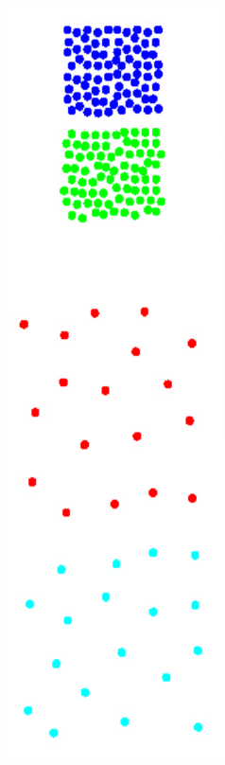
Limitations of Current Merging Schemes
(a)
(b)
Closeness schemes will merge (a) and (b)
(c)
Average connectivity schemes will merge (c) and (d)
(d)

Slide 7
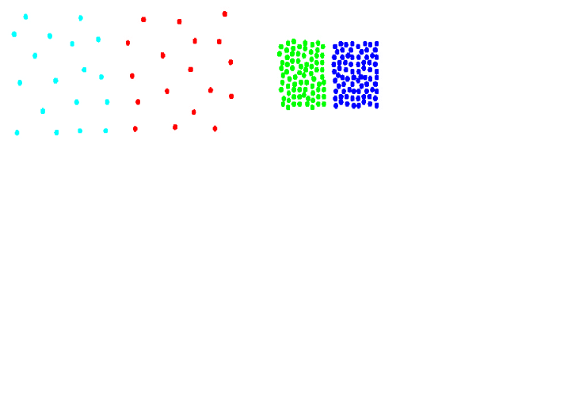
Chameleon: Clustering Using Dynamic Modeling
Adapt to the characteristics of the data set to find the natural clusters
Use a dynamic model to measure the similarity between clusters
Main property is the relative closeness and relative inter-connectivity of the cluster
Two clusters are combined if the resulting cluster shares certain properties with the constituent clusters
The merging scheme preserves self-similarity
One of the areas of application is spatial data

Slide 8
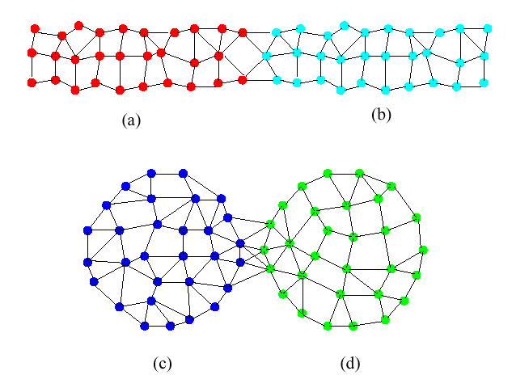
Limitations of Current Merging Schemes
(a)
(b)
(c)
(d)
Shows relative closeness
Shows inter connectedness

Slide 9
Chameleon: Steps
Preprocessing Step: Represent the Data by a Graph
Given a set of points, construct the k-nearest-neighbor (k-NN) graph to capture the relationship between a point and its k nearest neighbors
Concept of neighborhood is captured dynamically (even if region is sparse)
Phase 1: Use a multilevel graph partitioning algorithm on the graph to find a large number of clusters of well-connected vertices
Each cluster should contain mostly points from one “true” cluster, i.e., is a sub-cluster of a “real” cluster

Slide 10
Chameleon: Steps …
Phase 2: Use Hierarchical Agglomerative Clustering to merge sub-clusters
Two clusters are combined if the resulting cluster shares certain properties with the constituent clusters
Two key properties used to model cluster similarity:
Relative Interconnectivity: Absolute interconnectivity of two clusters normalized by the internal connectivity of the clusters
Relative Closeness: Absolute closeness of two clusters normalized by the internal closeness of the clusters

Slide 11
Relative Closeness

Slide 12
Relative Interconnectivity

Slide 15
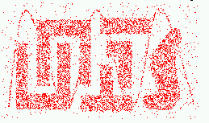
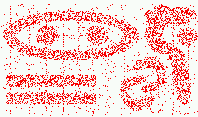
Characteristics of Spatial Data Sets
Clusters are defined as densely populated regions of the space
Clusters have arbitrary shapes, orientation, and non-uniform sizes
Difference in densities across clusters and variation in density within clusters
Existence of special artifacts (streaks) and noise
The clustering algorithm must address the above characteristics and also require minimal supervision.

Slide 16
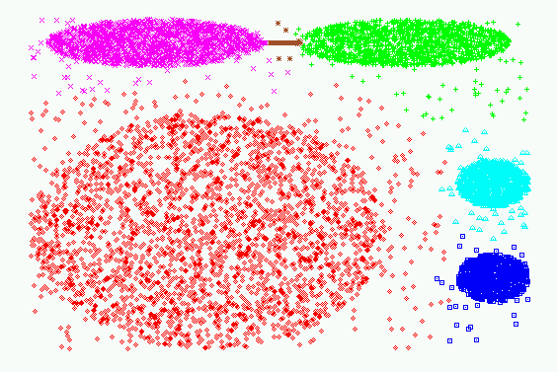
Experimental Results: CHAMELEON

Slide 17
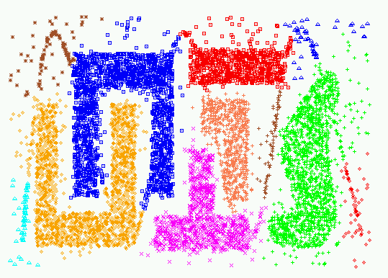
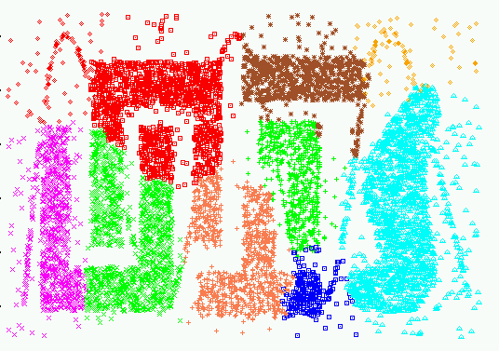
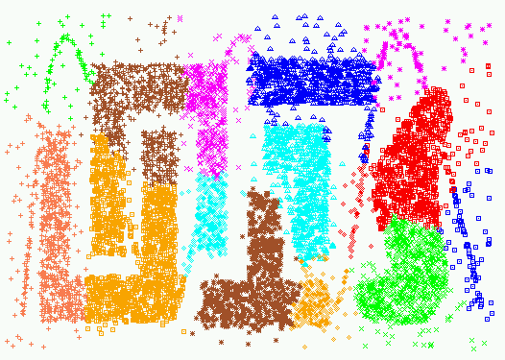
Experimental Results:
CHAMELEON
CURE (10 clusters)
CURE (15 clusters)

Slide 18
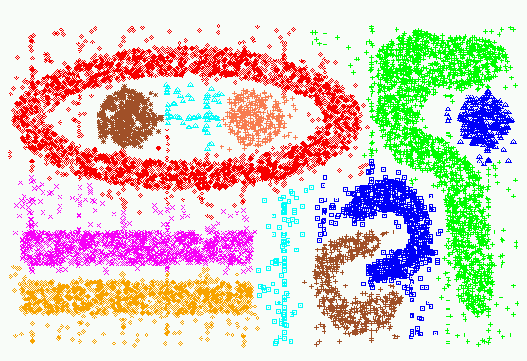
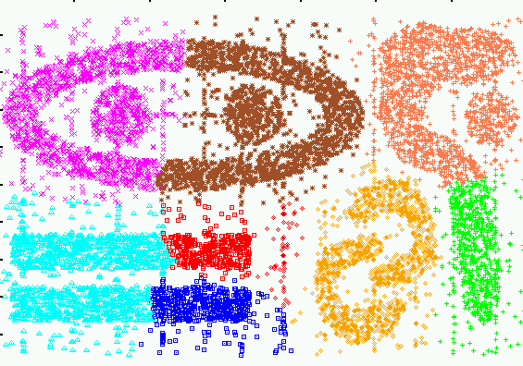
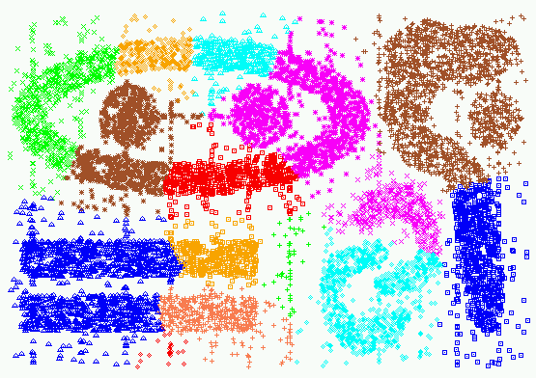
Experimental Results:
CHAMELEON
CURE (9 clusters)
CURE (15 clusters)

Slide 19
Shared Near Neighbor Approach
SNN graph: the weight of an edge is the number of shared neighbors between vertices given that the vertices are connected
i
j
i
j
4

Slide 22
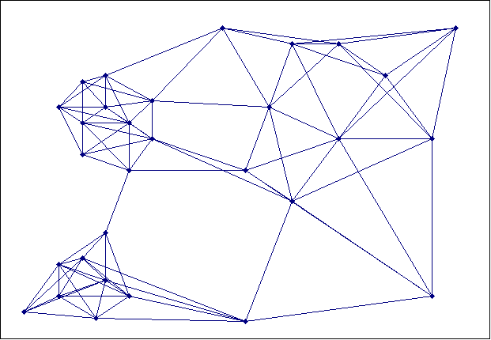
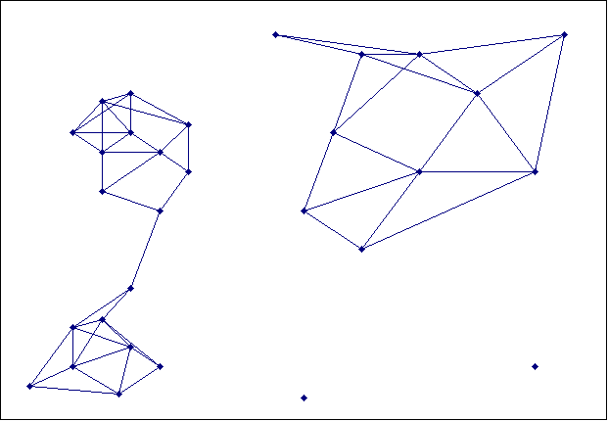
Creating the SNN Graph
Sparse Graph
Link weights are similarities between neighboring points
Shared Near Neighbor Graph
Link weights are number of Shared Nearest Neighbors

Slide 23
Jarvis-Patrick Clustering
First, the k-nearest neighbors of all points are found
In graph terms this can be regarded as breaking all but the k strongest links from a point to other points in the proximity graph
A pair of points is put in the same cluster if
any two points share more than T neighbors and
the two points are in each others k nearest neighbor list
For instance, we might choose a nearest neighbor list of size 20 and put points in the same cluster if they share more than 10 near neighbors
Jarvis-Patrick clustering is too brittle

Slide 25
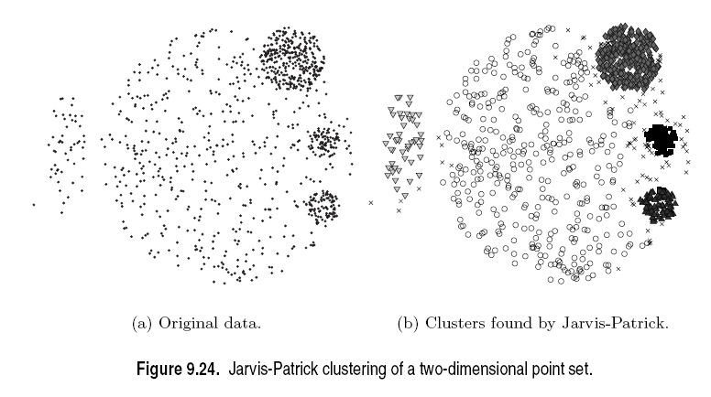

Slide 26
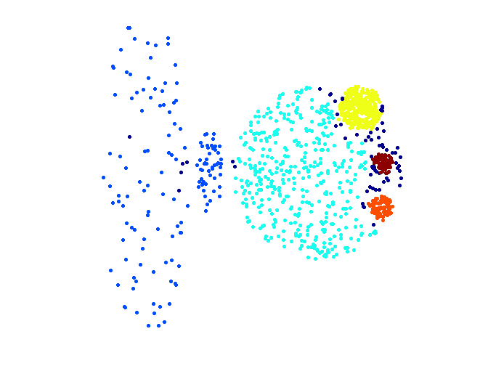
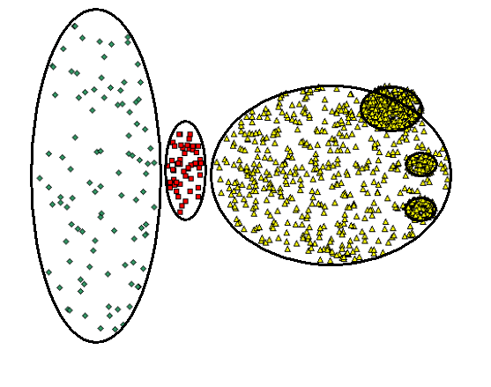
When Jarvis-Patrick Works Reasonably Well
Original Points
Jarvis Patrick Clustering
6 shared neighbors out of 20

Slide 27
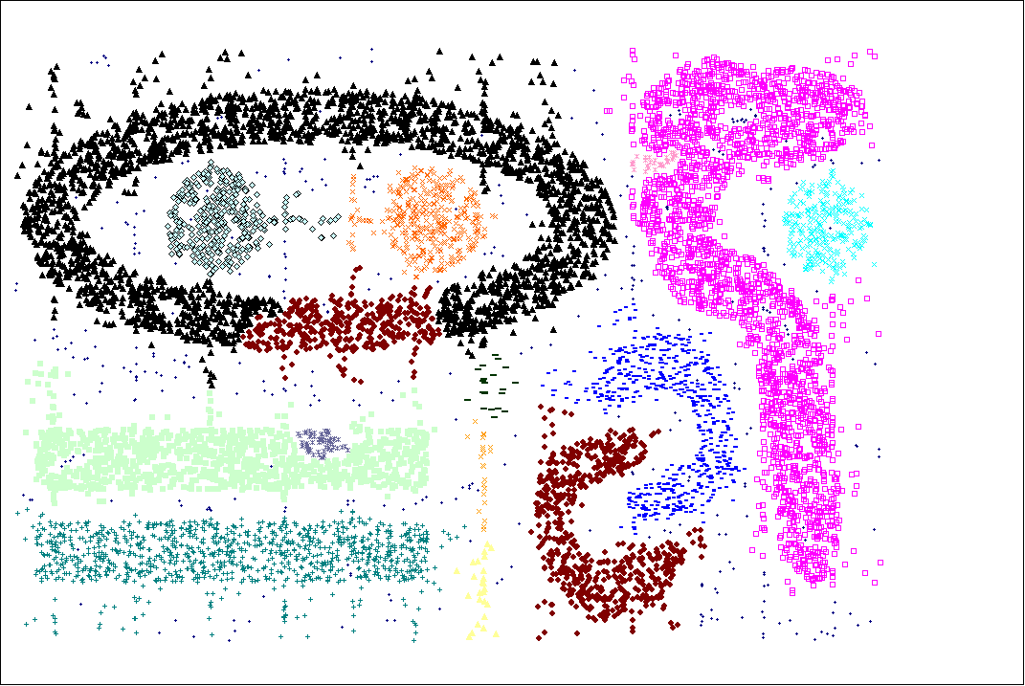
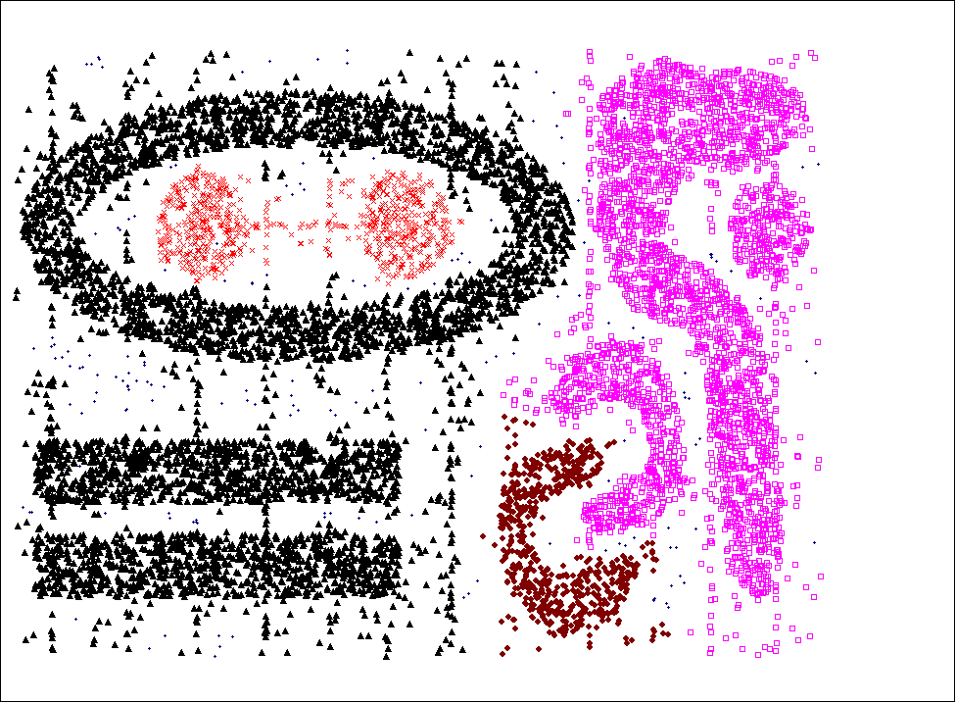
When Jarvis-Patrick Does NOT Work Well
Smallest threshold, T, that does not merge clusters.
Threshold of T - 1

Slide 28
SNN Density Clustering Algorithm
Compute the similarity matrix This corresponds to a similarity graph with data points for nodes and edges whose weights are the similarities between data points
Sparsify the similarity matrix by keeping only the k most similar neighbors This corresponds to only keeping the k strongest links of the similarity graph
Construct the shared nearest neighbor graph from the sparsified similarity matrix At this point, we could apply a similarity threshold and find the connected components to obtain the clusters (Jarvis-Patrick algorithm)
Find the SNN density of each Point Using a user specified parameters, Eps, find the number points that have an SNN similarity of Eps or greater to each point. This is the SNN density of the point

Slide 29
SNN Clustering Algorithm …
Find the core points Using a user specified parameter, MinPts, find the core points, i.e., all points that have an SNN density greater than MinPts
Form clusters from the core points If two core points are within a radius, Eps, of each other they are place in the same cluster
Discard all noise points All non-core points that are not within a radius of Eps of a core point are discarded
Assign all non-noise, non-core points to clusters This can be done by assigning such points to the nearest core point
(Note that steps 4-8 are DBSCAN)

Slide 30
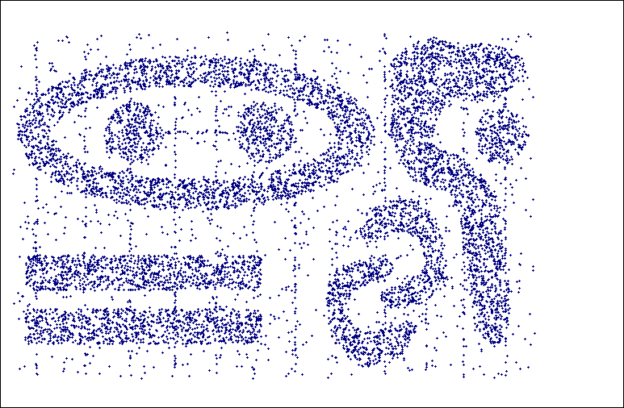
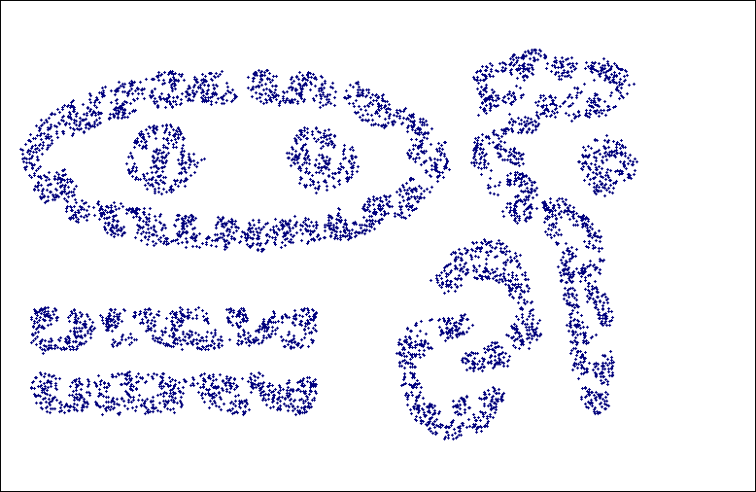
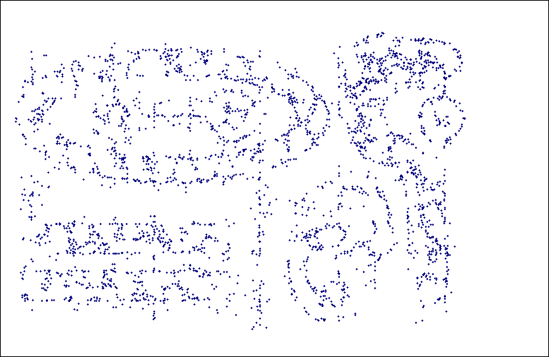
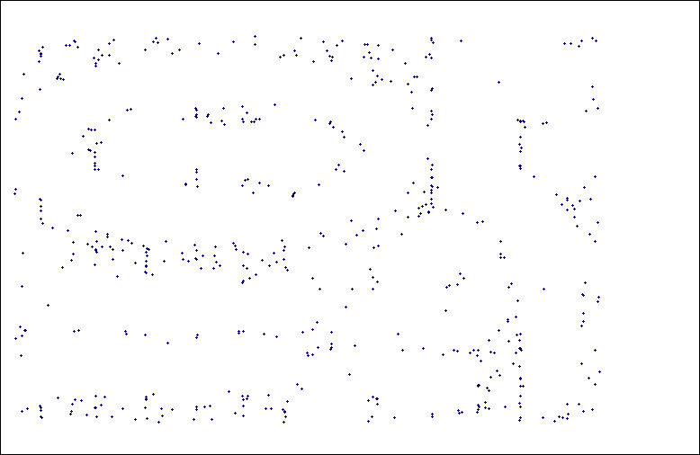
SNN Density
a) All Points b) High SNN Density
c) Medium SNN Density d) Low SNN Density

Slide 31
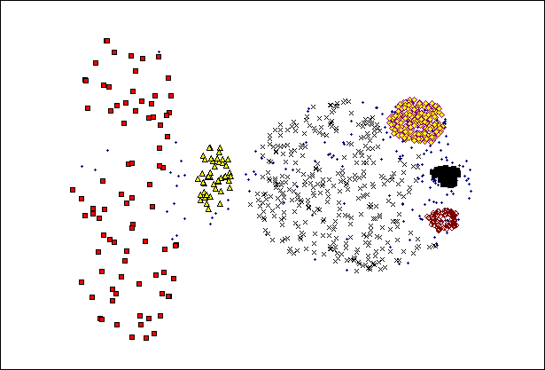
SNN Clustering Can Handle Differing Densities
Original Points
SNN Clustering

Slide 32
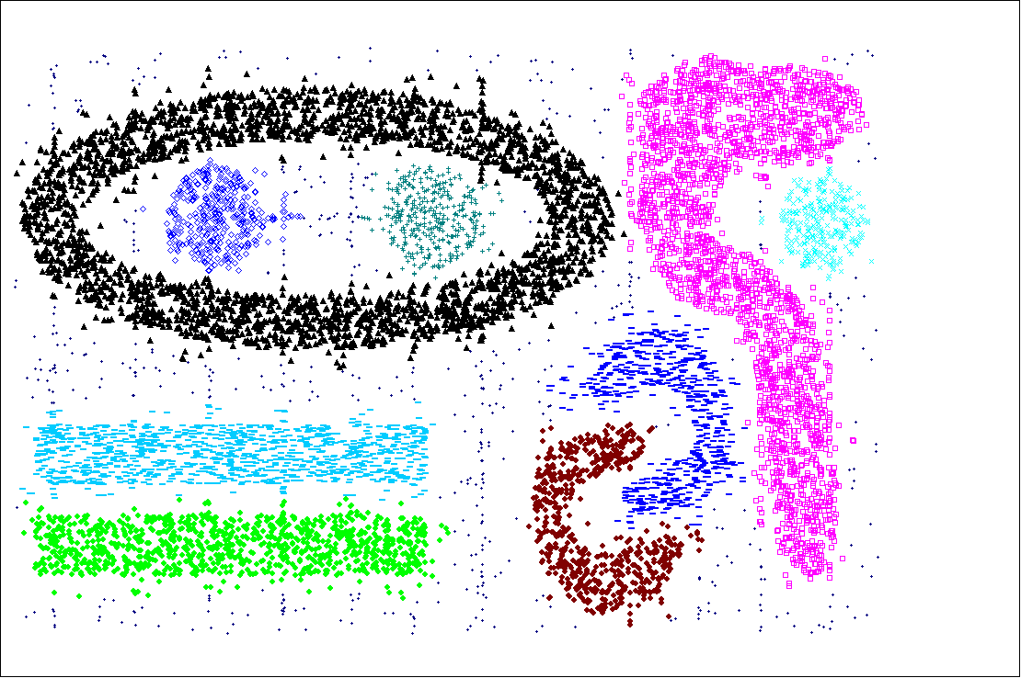
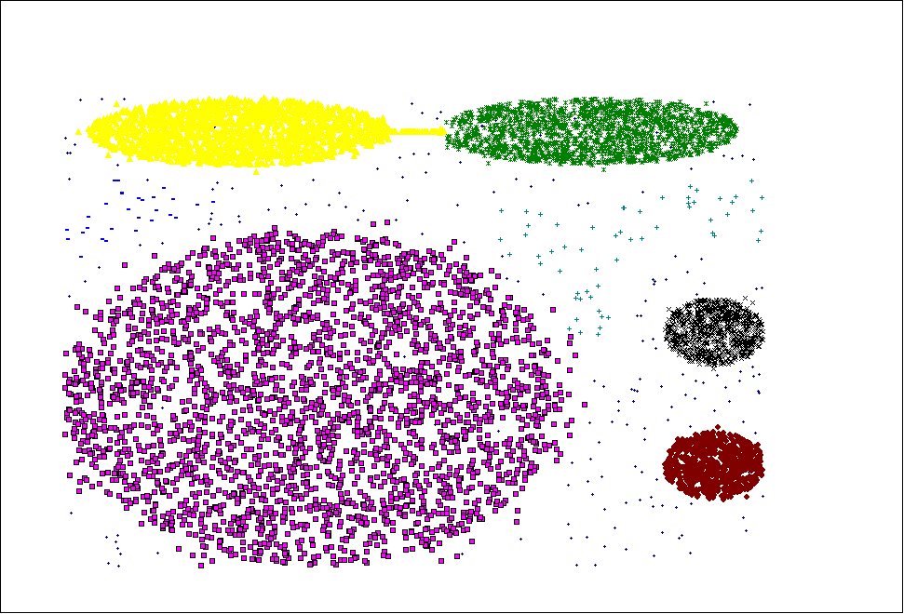
SNN Clustering Can Handle Other Difficult Situations

Slide 33
Finding Clusters of Time Series In Spatio-Temporal Data
SNN Clusters of SLP.
SNN Density of Points on the Globe.

Slide 34
Features and Limitations of SNN Clustering
Does not cluster all the points
Complexity of SNN Clustering is high
O( n * time to find numbers of neighbor within Eps)
In worst case, this is O(n²)
For lower dimensions, there are more efficient ways to find the nearest neighbors
R* Tree
k-d Trees

Slide 35
Clustering High-Dimensional Data
Clustering high-dimensional data
Many applications: text documents, DNA micro-array data
Major challenges:
Many irrelevant dimensions may mask clusters
Distance measure becomes meaningless—due to equi-distance
Clusters may exist only in some subspaces
Methods
Feature transformation: only effective if most dimensions are relevant
PCA & SVD useful only when features are highly correlated/redundant
Feature selection: wrapper or filter approaches
useful to find a subspace where the data have nice clusters
Subspace-clustering: find clusters in all the possible subspaces
CLIQUE, ProClus, and frequent pattern-based clustering

Slide 36
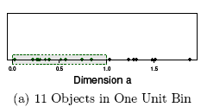
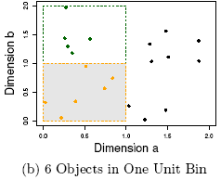
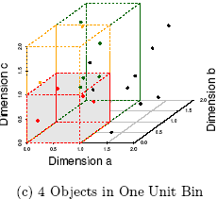
The Curse of Dimensionality (graphs adapted from Parsons et al. KDD Explorations 2004)
Data in only one dimension is relatively packed
Adding a dimension “stretch” the points across that dimension, making them further apart
Adding more dimensions will make the points further apart—high dimensional data is extremely sparse
Distance measure becomes meaningless—due to equi-distance

Slide 37
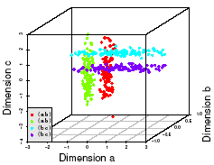
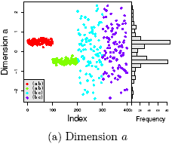
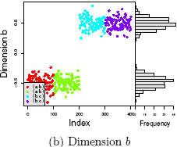
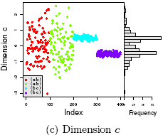
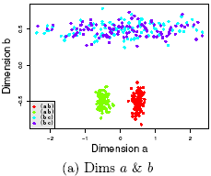
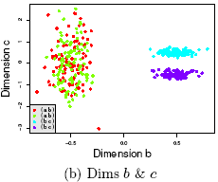
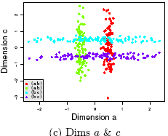
Why Subspace Clustering? (adapted from Parsons et al. SIGKDD Explorations 2004)
Clusters may exist only in some subspaces
Subspace-clustering: find clusters in all the subspaces

Slide 38
CLIQUE (Clustering In QUEst)
Agrawal, Gehrke, Gunopulos, Raghavan (SIGMOD’98)
Automatically identifying subspaces of a high dimensional data space that allow better clustering than original space
CLIQUE can be considered as both density-based and grid-based
It partitions each dimension into the same number of equal length interval
It partitions an m-dimensional data space into non-overlapping rectangular units
A unit is dense if the fraction of total data points contained in the unit exceeds the input model parameter
A cluster is a maximal set of connected dense units within a subspace

Slide 39
CLIQUE: The Major Steps
Partition the data space and find the number of points that lie inside each cell of the partition.
Identify the subspaces that contain clusters using the Apriori principle
Identify clusters
Determine dense units in all subspaces of interests
Determine connected dense units in all subspaces of interests.
Generate minimal description for the clusters
Determine maximal regions that cover a cluster of connected dense units for each cluster
Determination of minimal cover for each cluster

Slide 40
Salary (10,000)
Vacation(week)
7
7
6
6
5
5
4
4
3
3
2
2
1
1
0
age
0
age
20
30
40
50
60
20
30
40
50
60
τ = 3
Vacation
Salary
30
50
age

Slide 41
Strength and Weakness of CLIQUE
Strength
automatically finds subspaces of the highest dimensionality such that high density clusters exist in those subspaces
insensitive to the order of records in input and does not presume some canonical data distribution
scales linearly with the size of input and has good scalability as the number of dimensions in the data increases
Weakness
The accuracy of the clustering result may be degraded at the expense of simplicity of the method

Slide 42
DENCLUE: Using Statistical Density Functions
DENsity-based CLUstEring by Hinneburg & Keim (KDD’98)
Using statistical density functions:
Major features
Solid mathematical foundation
Good for data sets with large amounts of noise
Allows a compact mathematical description of arbitrarily shaped clusters in high-dimensional data sets
Significant faster than existing algorithm (e.g., DBSCAN)
But needs a large number of parameters

Slide 43
Denclue: Technical Essence
Uses grid cells but only keeps information about grid cells that do actually contain data points and manages these cells in a tree-based access structure
Influence function: describes the impact of a data point within its neighborhood
Overall density of the data space can be calculated as the sum of the influence function of all data points
Clusters can be determined mathematically by identifying density attractors
Density attractors are local maximal of the overall density function

Slide 44
Summary
Cluster analysis groups objects based on their similarity and has wide applications
Measure of similarity can be computed for various types of data
Clustering algorithms can be categorized into partitioning methods, hierarchical methods, density-based methods, grid-based methods, and model-based methods
Outlier detection and analysis are very useful for fraud detection, etc. and can be performed by statistical, distance-based or deviation-based approaches
There are still lots of research issues on cluster analysis

